Slide 1
Media-based Modulation
Amir K. Khandani
khandani@uwaterloo.ca
E&CE Department, University of Waterloo
khandani@uwaterloo.ca, 519-8851211 ext 35324

Slide 2
Media-based vs. (legacy) Source-based
Main idea:
  Embed the information in the variation of the RF channel external to the antenna.
Benefits vs. (legacy) source-based wireless:
    Additive information over multiple receive antennas (similar to MIMO) with the advantages of:
      Using a single transmit antenna
      Independence of noise over receive antennas
    Inherent diversity over a static channel (constellation diversity) using single or multiple antenna(s)
      Diversity improves with the number of constellation points
      Unlike MIMO, diversity does not require sacrificing the rate
      It essentially coverts the Raleigh fading channel into an AWGN channel with the same average receive energy and with a minor loss in capacity.

Slide 3

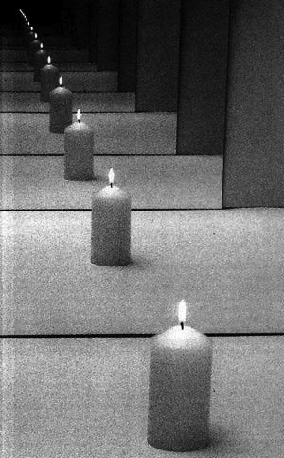
Media-based Wireless
Data
Exponential growth due to rich scattering
Carrier
Keep the source shining and change the media
Rich scattering environment:
  Slightest perturbation in the environment causes independent outcomes.
Should not be confused with RF beam-forming using parasitic elements.
  RF beam-forming aims at focusing energy.
  Media-based relies on additive information over receive antennas to increase rate, and on randomness of constellation to combat slow fading.

Slide 4
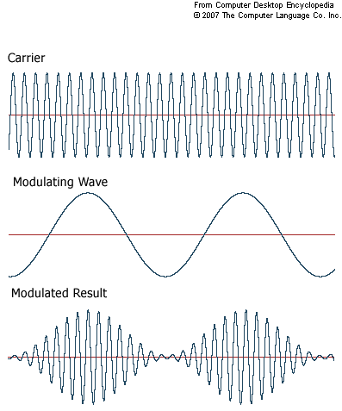
Media-based: Signaling Scheme
DT
T
T
T
At these times, coded (FEC) bits are used to select one of possible channel states.
Coded Data
Media-based
one complex
dimension
Basis: Orthogonal
Complex Dimensions: D
E
Raleigh channel of impulse response of length D.

Slide 5
Media-based: Rate
m: Data
Carrier
Vectors of Dimension K,
K=2Q is the # of Receive Antennas
: K-D constellation (iid Gaussian elements)
5

Slide 6
Gain due to Inherent Diversity:
Typicality of Random Constellation
Carrier of Energy E
AWGN:
m: Data

Slide 7
Main Computational Tool

Slide 8
Main Conclusion of
Consider a slow Raleigh fading channel for which statistical average of the fading gain per receive antenna is one.
  Using a single TX and Q RX antennas over such channel, mutual information averaged over different realizations of a constellation with L points approaches the capacity of 2Q parallel AWGN channels, each with unit energy, as

Slide 9
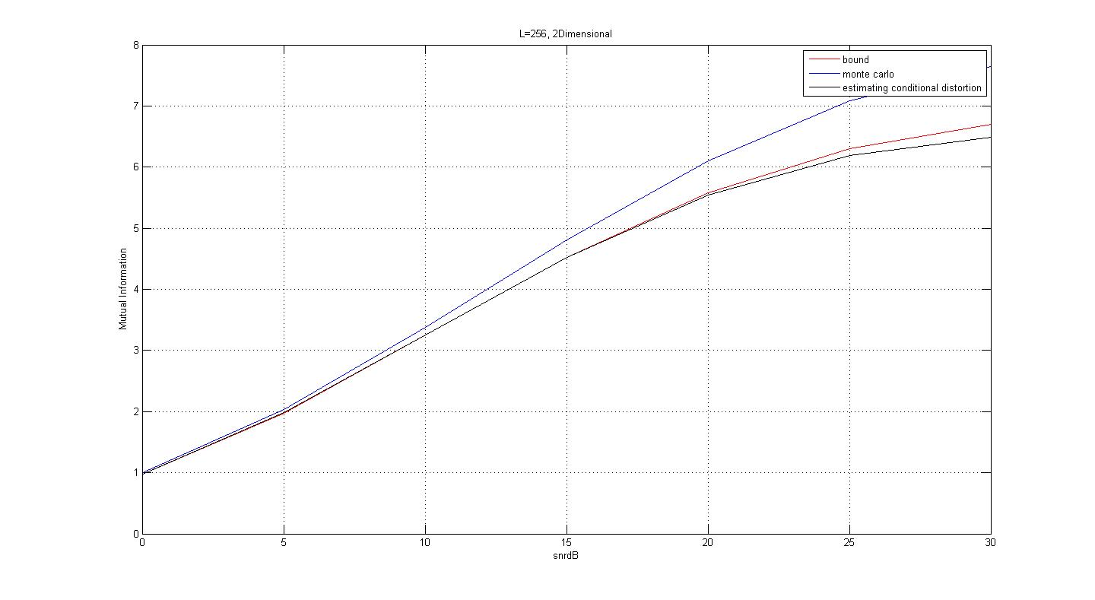
Accuracy of the Computational Tool and its Simplified Version in Non-asymptotic Situations
L=256, Q=1 (SISO)
Simulation of the
actual average
Simplified
analytical
bound
Simulation of the
analytical bound
Mutual Information
SNR

Slide 10
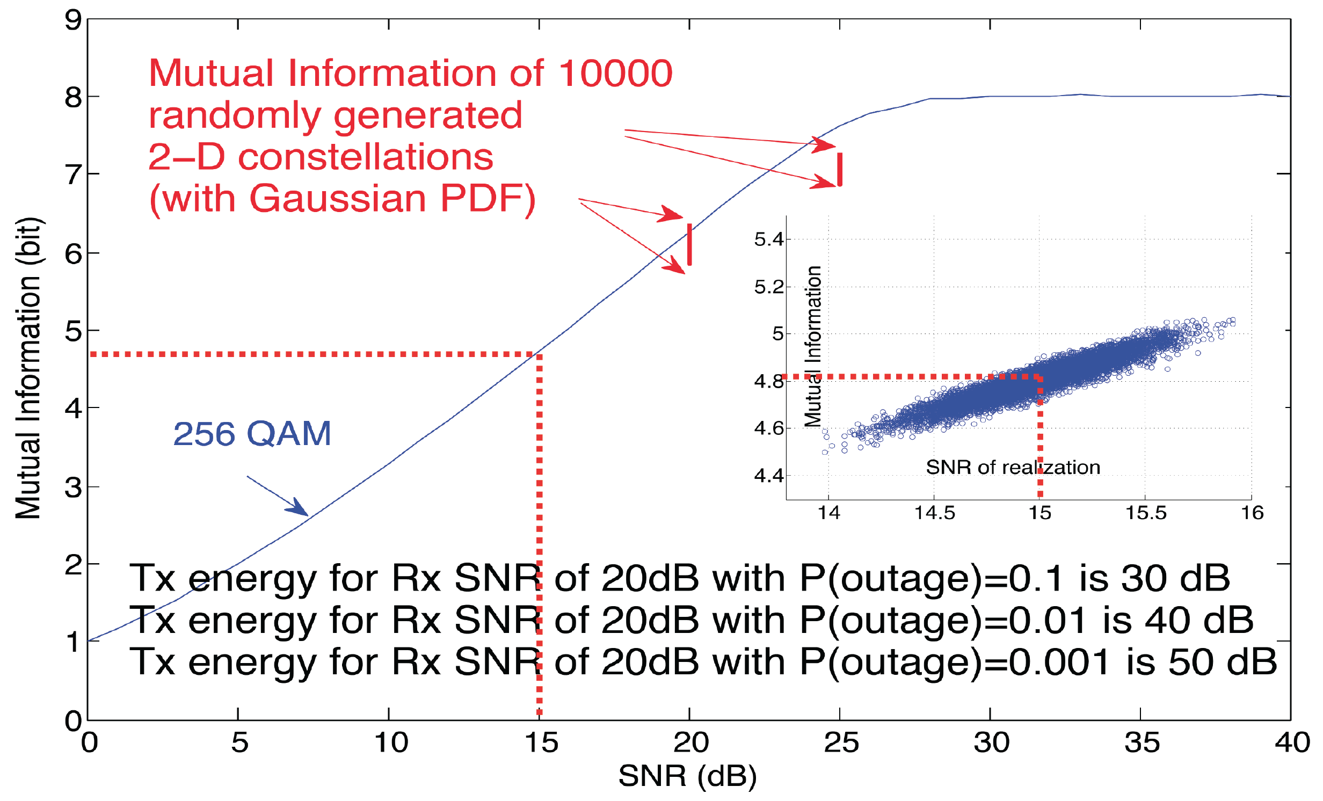
Main Benefit: Inherent Diversity in A Single Constellation
Conventional method suffer from deep fades in slow fading.
This problem disappear as “Good and Bad” channel realizations contribute to forming the constellation.

Slide 11
Media-based vs. Source-based
E/K
KxK
MIMO
K complex
Dimensions
Total signal energy: KE
Basis: Non-orthogonal
Complex Dimensions/sec/Hz: K
E/K
H
E/K
Better Performance
Data
Media-based
one complex
dimension
Total signal energy: KE
Basis: Orthogonal
Complex Dimension/sec/Hz: K
E

Slide 12
Media-based vs. Legacy Systems:
Effective Dimensionality
: Eigenvalues of a KxK Wishart random matrix
KxK legacy MIMO
1xK Media-based
Rate
Legacy SISO
Rate=log(1+E)
E

Slide 13
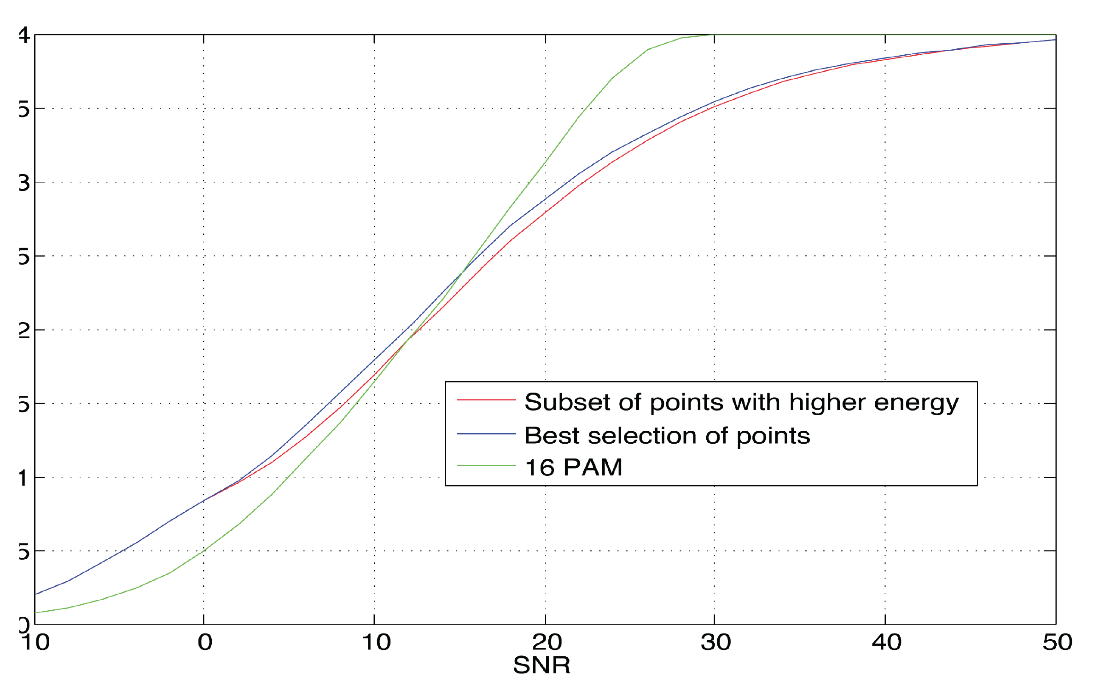
Selection Gain
Select a subset of points, which, subject to uniform probabilities, maximize the mutual information.
In practice, using the subset of points with highest energy, which maximizes the slope the rate at zero SNR, performs very well.

Slide 14
Media-based vs. Legacy Systems:
Slope of Rate vs. SNR (dB) at SNR=0
Legacy SISO: Slope=1
Legacy KxK MIMO: Maximum eigenvalue of a KxK Wishart matrix (upper limited by 4)
1xK Media-based: K
Selection Gain further increases the slope of media-based to:
  e.g. average slope scales as log(L) for SISO case.
 | L=1, K=2 | L=1, K=4 | L=1, K=8 | L=1, K=infinity
KxK MIMO | 1.75 | 2.45 | 2.96 | 4
1xK Media-based | 2 | 4 | 8 | Infinity

Slide 15
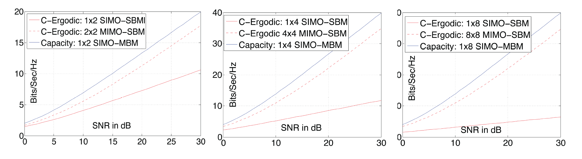
Comparison with Ergodic Capacity

Slide 16
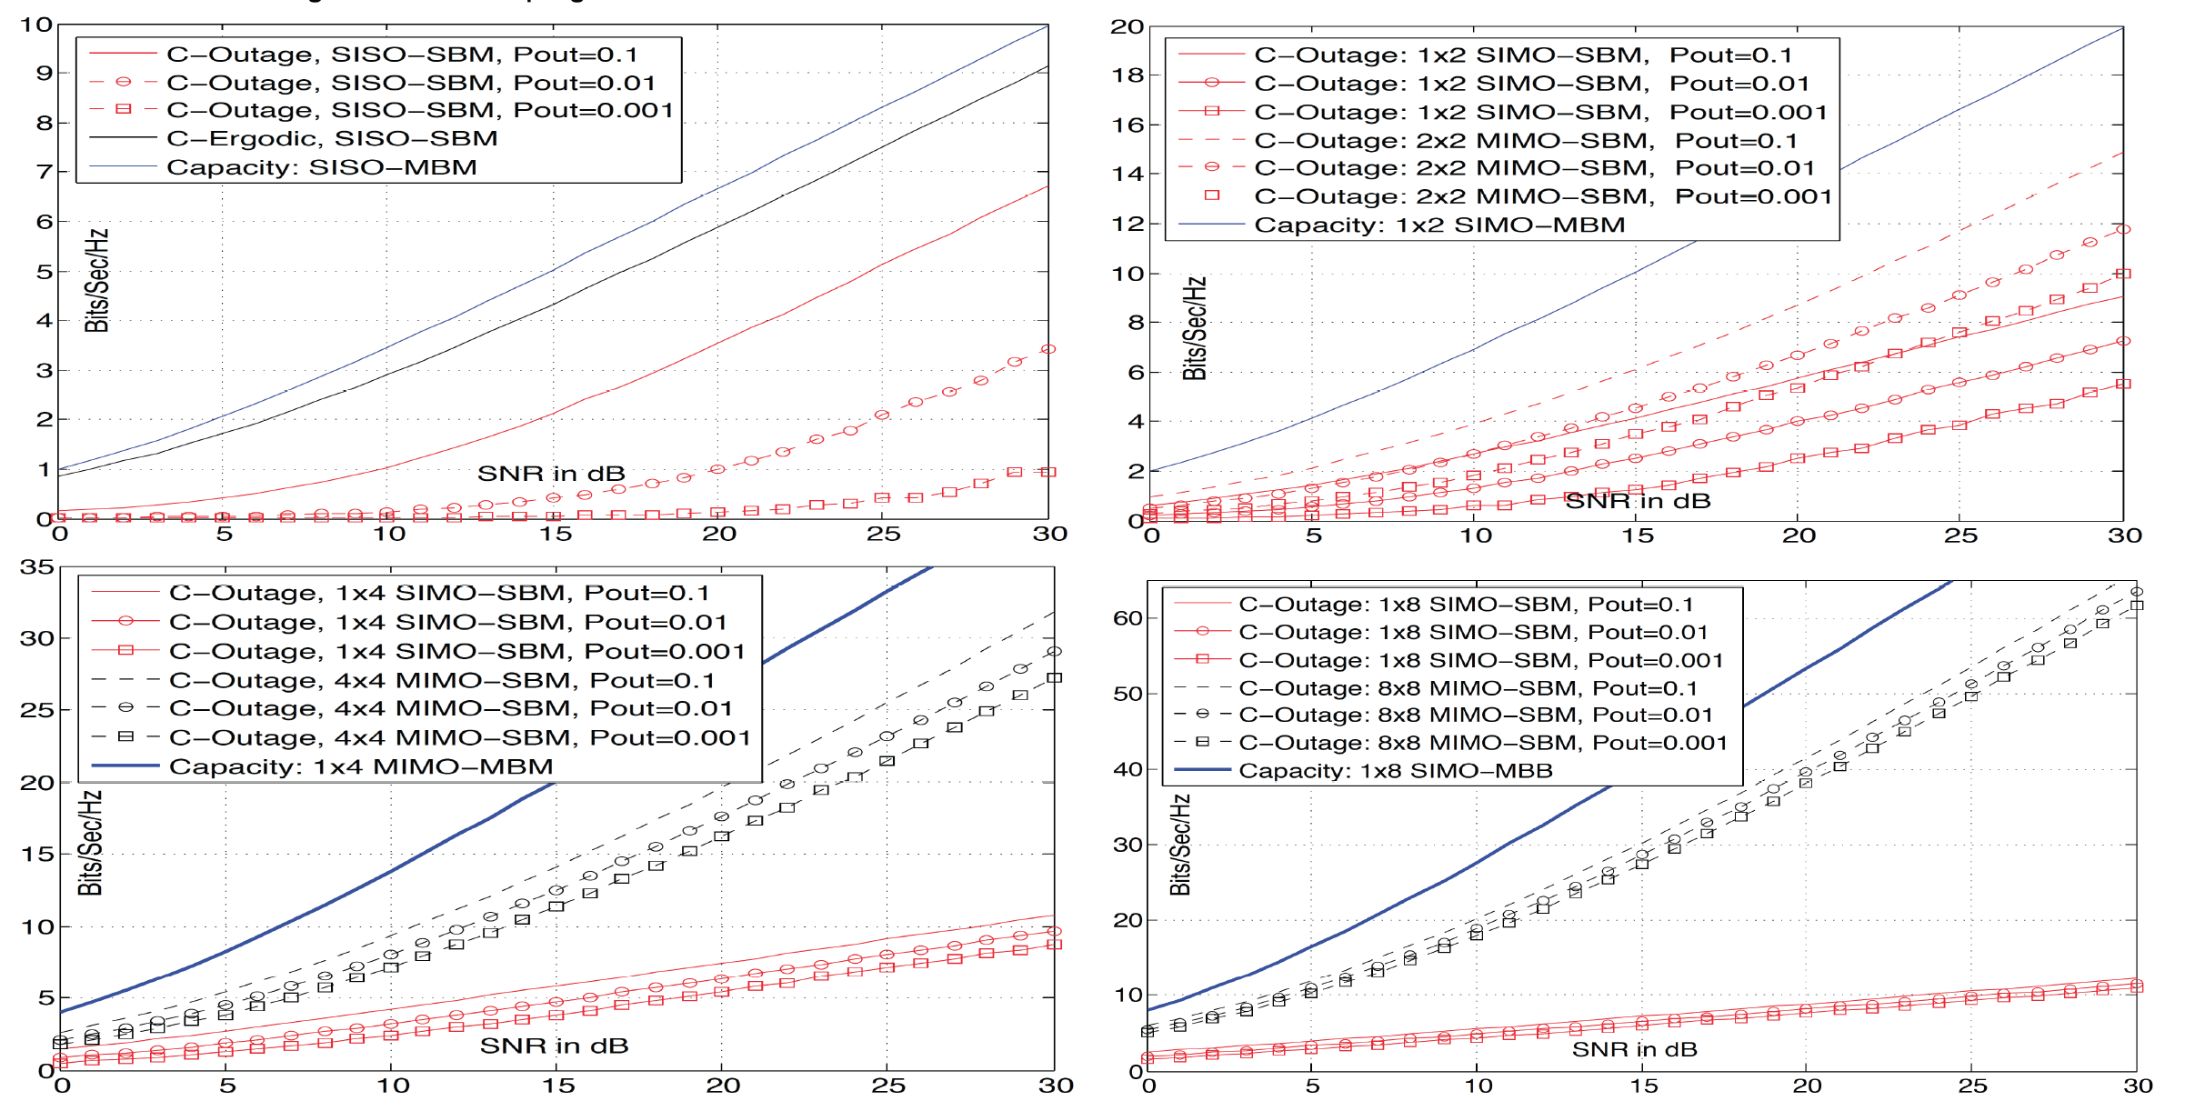
Comparison with Outage Capacity

Slide 17
Questions/Comments?
Please kindly contact
khandani@uwaterloo.ca

