Slide 1
Aug. 10th 2012
Beyond MIMO:
Media-based Wireless
Amir K. Khandani
B.Sc./M.Sc. Tehran University, Ph.D. McGill University
Canada Research Chair
RIM-NSERC Industrial Research Chair
E&CE Department, University of Waterloo
khandani@uwaterloo.ca, 519-8851211 ext 35324
Canada Research Chairs

Slide 2
A New Paradigm in Wireless: Media-based vs. (legacy) Source-based
Main idea:
Embed the information in the variation of the RF channel external to the antenna.
Benefits vs. (legacy) source-based wireless:
Additive information over multiple receive antennas (similar to MIMO) with the advantages of:
Using a single transmit antenna
Independence of noise over receive antennas
Inherent diversity over a static channel (constellation diversity) using single or multiple antenna(s)
Diversity order improves with the number of constellation points
Unlike MIMO, diversity does not necessitates sacrificing the rate
It essentially coverts the Raleigh fading channel into an AWGN channel with the same average receive energy and with a minor loss in capacity.
Harvesting transmit energy using multiple receive antennas

Slide 3
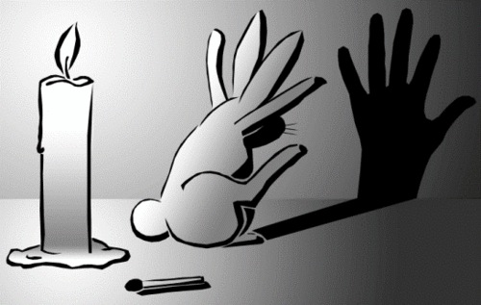
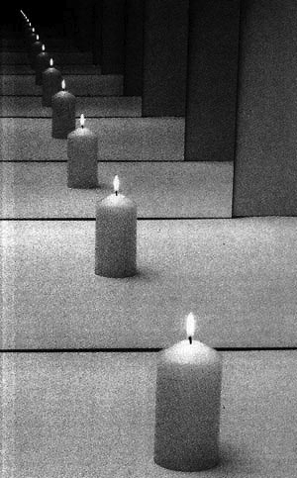
Media-based Wireless
Data
Exponential growth due to rich scattering
Carrier
Keep the source shining and change the media
Enjoy rich variations with small changes in media
Rich scattering environment: slightest perturbation in the environment causes independent outcomes.
Variations of phase is critical and can be exploited with stable TX/RX synchronization using two-way link (continually sending back pilot from RX to TX).

Slide 4
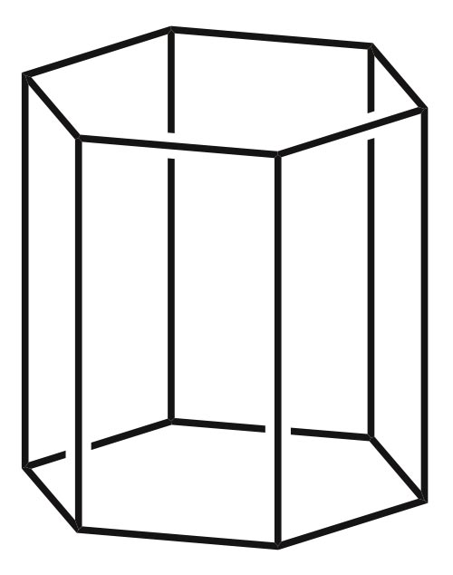
How to Change the RF Channel? Just An Example
Enhancing rich scattering (near field reflections & openings in walls for wave to exit)
Surfaces with
controllable
RF properties
Antenna sending a
Fixed/shaped carrier
Separately control some of RF properties, i.e. of each surface, e.g., on-off partial mirrors, according to the input data (media-based) or randomly (security).
More details at: www.cst.uwaterloo.ca/2way

Slide 5
Media-based: Signaling Scheme
LT
T
T
T
At these times, coded (FEC) bits are used to select one of possible channel states.
Coded Data
Media-based
one complex
dimension
Total signal energy: LE
Basis: Orthogonal
Complex Dimensions: L
E
Raleigh channel of impulse response of length L.

Slide 6
Media-based: Rate
m: Data
Carrier
(unit energy)
Vectors of Dimension K
K = # of Receive Antennas
: K-D constellation (iid Gaussian elements)
For low SNR, i.e., prior to
saturation to
6

Slide 7
Media-based vs. Source-based
E/K
KxK
MIMO
K complex
Dimensions
Total signal energy: E
Basis: non-orthogonal
Complex Dimensions/sec/Hz: K
E/K
H
E/K
E/K
Better Performance
Parallel
SISO
K complex
dimensions
E/K
Total signal energy: E
Basis: Orthogonal
Complex Dimensions/sec/Hz: K
E/K
Data
Media-based
one complex
dimension
Total signal energy: LKE
Basis: Orthogonal
Complex Dimension/sec/Hz: K
E

Slide 8
Media-based vs. Legacy Systems: Effective Dimensionality
: Eigenvalues of a KxK Wishart random matrix
KxK legacy MIMO
1xK Media-based
Rate
Legacy SISO
Rate=log(1+E)
E

Slide 9
Asymptotic Gain (for E→∞) in Rate and Energy

Slide 10
Asymptotic Gain (for E→∞) in Energy & Rate
K | L | KL
1 | 2 | 2 | 4.2 bits | 6.4 dB
2 | 1 | 2 | 4.2 bits | 9.4 dB
1 | 4 | 4 | 13.0 bits | 9.8 dB
4 | 1 | 4 | 13.0 bits | 15.8 dB
1 | 8 | 8 | 34.8 bits | 13.1 dB
8 | 1 | 8 | 34.8 bits | 22.1 dB
1 | 16 | 16 | 86.4 bits | 16.2 dB
16 | 1 | 16 | 86.4 bits | 28.2 dB

Slide 11
Media-based vs. Legacy Systems: Slope of Rate vs. SNR (dB) at SNR=0
Legacy SISO: Slope=1
Legacy KxK MIMO: Maximum eigenvalue of a KxK Wishart matrix (upper limited by 4)
1xK Media-based: LK
 | L=1, K=2 | L=1, K=4 | L=1, K=8 | L=1, K=infinity
KxK MIMO | 1.75 | 2.45 | 2.96 | 4
1xK Media-based | 2 | 4 | 8 | Infinity

Slide 12
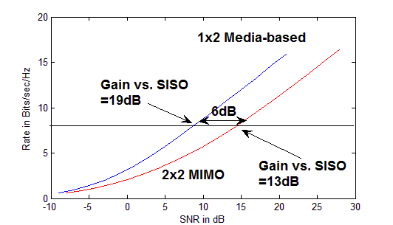
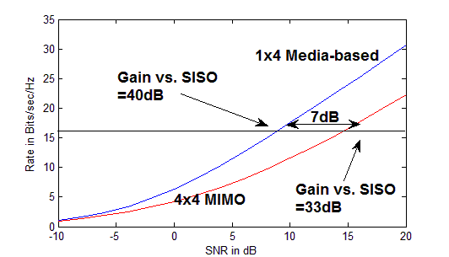
Media-based vs. Legacy MIMO
2 or 4 antenna with a rate of 4 bits/s/Hz/antenna is typical in current systems
L=1,K=2
L=1,K=4
Relative Gain of Media-based will be much higher for L>1, typically L>>1
MIMO works well only at high SNR values, but in some applications, e.g., optical transmission where MIMO is formed over different polarizations, or very lower power wireless, it is important to use spatial degrees of freedom offered by multiple antennas to save energy.

Slide 13
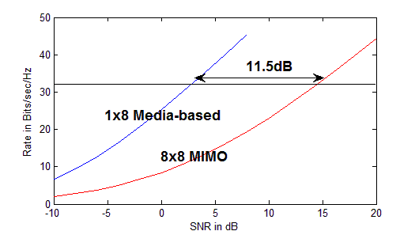
Media-based vs. Legacy MIMO
8 antenna systems with a rate of 4 bits/s/Hz/antenna
L=1,K=8
Relative Gain of Media-based will be much higher for L>1, usually L>>1.
1xK media-based is significantly simpler than KxK MIMO.
At low SNR, unlike MIMO, media-based is optimum.
At high SNR, energy saving of media-based vs. MIMO is significant and increases with the number of antennas.

Slide 14
Some Remarks
Power spectrum for media-based:
Linear time-varying (LTV) while legacy systems are linear time-invariant (LTI).
LTV can cause frequency expansion.
Received Power Spectrum: Average of channels’ spectrums times input spectrum
Input spectrum is shaped to limit the bandwidth.
Equalization:
Channels with an impulse response of length L provides L extra dimensions per receive antenna (inserting time gaps between subsequent transmissions).

Slide 15
Gain due to Inherent Diversity: Typicality of Random Constellation
Carrier of Energy E
AWGN:
m: Data

Slide 16
Modeling Discrete Constellation= Additional Additive Noise Variance of Additional Noise Power
Two dimensional space:

Slide 17
Example for Behavior of Mean and Standard Deviation of Additional Noise
 | 2 dimensions (Q=1) | 4 dimensions (Q=2) | 8 dimensions (Q=4)
Mean | 0.0078 | 0.1619 | 0.9140
Standard Deviation | 0.0078 | 0.0870 | 0.1363
Constellation with L=256 points

Slide 18
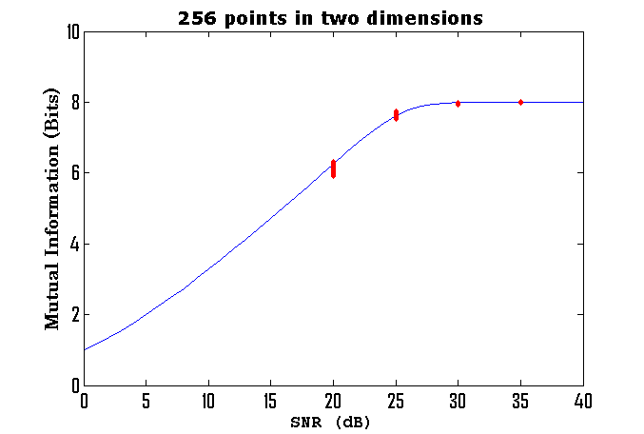
Inherent Diversity Gains
Mutual Information of 1000 randomly generated two dimensional constellations (generated with Gaussian PDF).
256 QAM
TX energy for RX SNR of 20dB with P(outage)=0.1 is 50dB, Gain=30dB
TX energy for RX SNR of 20dB with P(outage)=0.01 is 60dB, Gain=40dB
TX energy for RX SNR of 20dB with P(outage)=0.01 is 70dB, Gain=50dB

Slide 19
SISO Case Revisited
TX block is a train of K consecutive base TX signals, followed by L-1 zeros prior to the next TX block.
Channel in changed in each of K time slots among 2^{r} possibilities, resulting in a linear system with a random impulse response.
Time shift in input results in the same time shift in the response.
Oversample RX signal (sum of time-shifted responses) by L.
KL samples are full rank, yielding LK²/(L+K-1) dimensions per unit time.
Extra dimensions are correlated, degrading the performance.
Noise is correlated, improving the performance.
Iterative or Trellis decoding can be used for detection.
Source code-book is composed of a discrete set of shells (circular shells) with uniform phase.

Slide 20
More discussion on Media-based, including discussions on embedding information in both source and channel are at: www.cst.uwaterloo.ca

Slide 21
Realizing (external to antenna) RF Perturbation
Objective: Create several random, selectable, options for propagation path
Simpler than traditional beam-forming
No need for tuning/control, having specific patterns, or concentration of energy

Slide 22
Candidates for RF Channel Perturbation
Photonic microwave
Changing waveguide property by surface plasma generated through light source
Uses several photo masks for plasma grating
Creating surface plasma in an external to antenna parasitic object
Uses light intensity to change plasma depth
Electrically tunable impendence surface
Leaky wave antenna (based on a waveguide with tunable surface leakage)
Electrically changeable impedance surface as an external to antenna parasitic element
Changing the permeability of ferrite under the effect of a magnetic field (e.g., via a current-carrying coil)
Changing the permittivity of ferroelectric material under the effect of an electric field (e.g., via a bias voltage)
Using meta-material as an external to antenna parasitic object with changeable refraction index

Slide 23
Security Applications: One-time Pad (Vernam Cipher)

Slide 24
Unbreakable Security: Vernam Cipher, One-time Pad
Vernam Cipher, One-time Pad: Bit-wise XOR of a (non-reusable) mask with the message
Generalization:
Happens naturally in wireless transmission
Each random phase can completely mask one PSK symbol.
Z
X
+
Y=X+Z (mod 2), X,Y,Z are binary, I(X;Y)=0
Z
X
+
Y=X+Z (mod 2π), X,Y,Z are angle, I(X;Y)=0

Slide 25
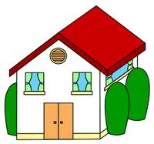
Exploiting Channel Randomness to Share a Common Phase (Key)
Closed loop gain is unique to Alice and Bob (determined by the fine details of the propagation path between them).
After extracting , RF environment around Alice and/or Bob is perturbed and a new phase value is extracted.

Slide 26
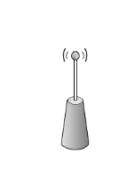
Key Generation: A Simpler Approach
?
?
Baseband
Eve
Baseband
MOD
TX
TX
MOD
G₁₂
G₂₁
I₂
I₁
O₁
G₁₁
G₂₂
O₂
DEM
RX
RX
DEM

Slide 27
Exploiting Channel Randomness to Share a Common Phase (Key)
Key Point: Each TX antenna should be used only once for each channel perturbation.
Challenges:
Synchronizing the two parties to agree on phase.
Providing a new common random phase for each PSK symbol.
Two-way wireless solves both these challenges.
Errors in common phase values are corrected by the overall channel code.
Hardware implementation shows that the common phase values can be measured with very high precision.

Slide 28
Exploiting Channel Randomness to Share a Common Phase (Key)
Two algorithms are provided for key generation.
Please see www.cst.uwaterloo.ca/2way for details.

Slide 29
More discussion on security, including discussions on causing confusion using legitimate jamming, embedding information in both source and channel are at: www.cst.uwaterloo.ca

Slide 30
Thank You! Questions/Comments?
Amir K. Khandani
E&CE Department, University of Waterloo
khandani@uwaterloo.ca, 519-8851211 ext 35324

